Slide 1

Unit -2 ( topic : Student’s t-test ROC Curves & EDA )

Slide 2
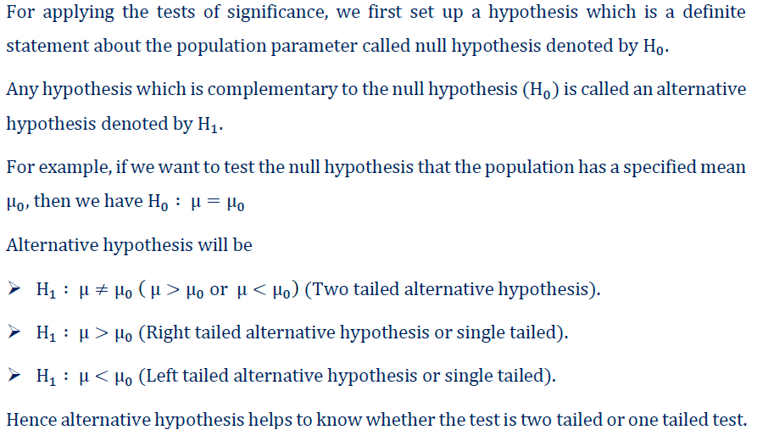
Test of Significance

Slide 3
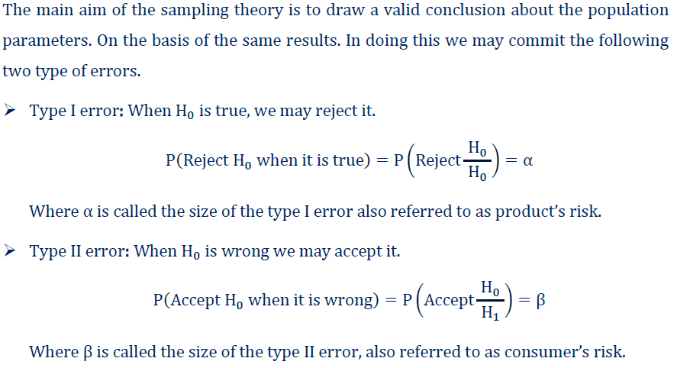

Slide 4
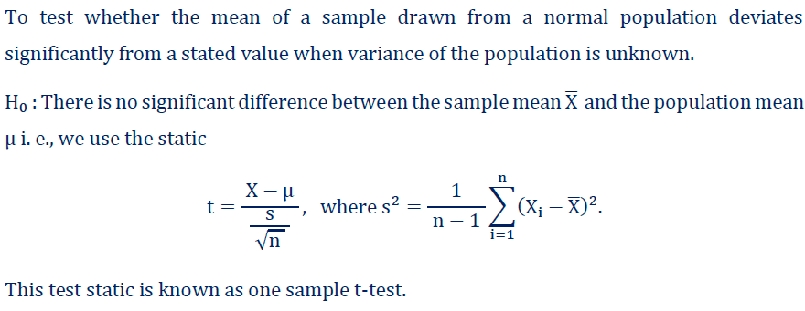
Student’s t-test
The one-sample t-test is the statistical test used to determine whether an unknown population mean is different from a specific value.
For example, comparing the mean height of the students with respect to the national average height of an adult.

Slide 5
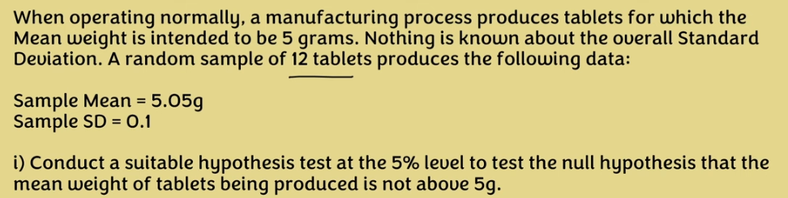
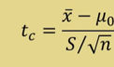
Question : 1
In Exam H0 is given

Slide 6
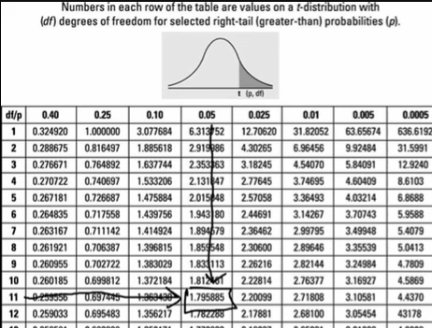

Slide 7
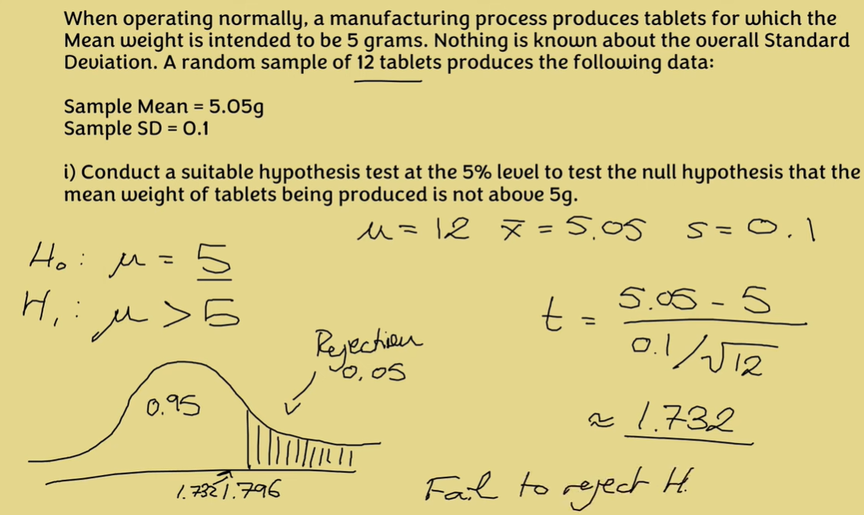

Slide 8
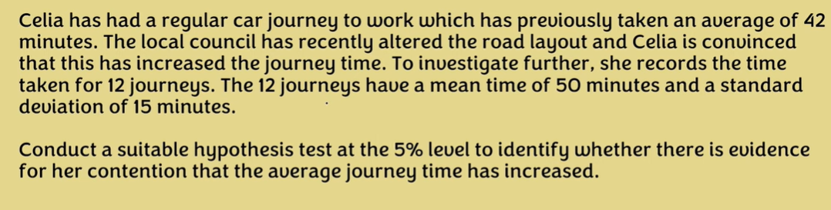
Question : 2

Slide 9
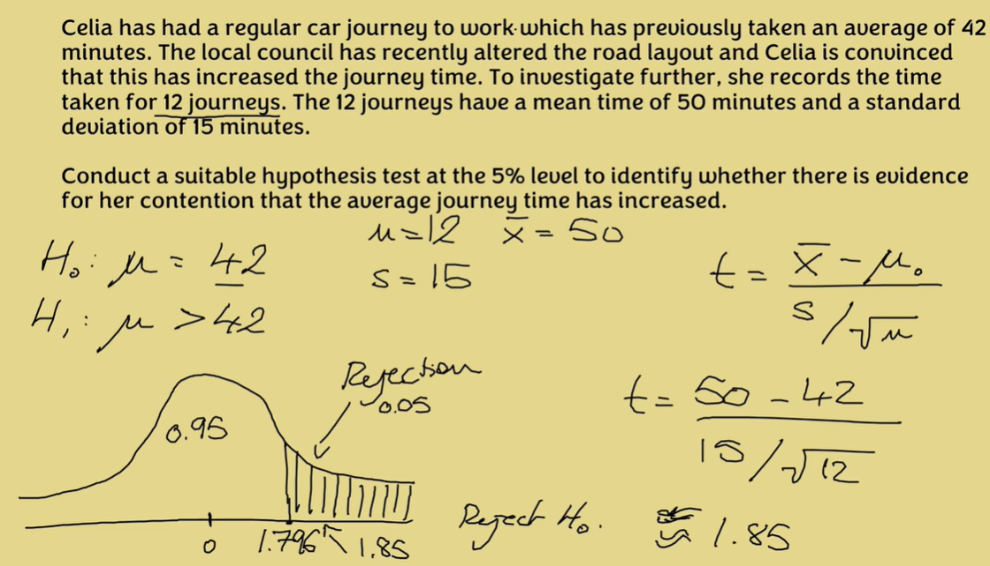

Slide 10
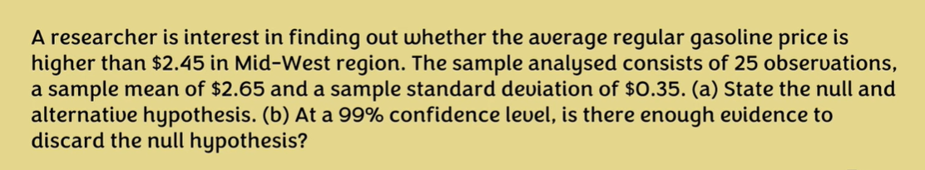
Question : 3

Slide 11
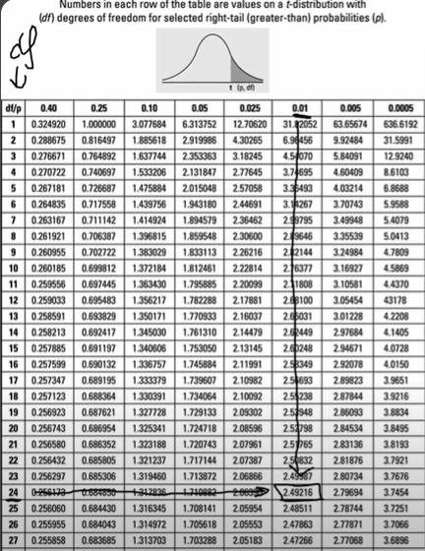

Slide 12
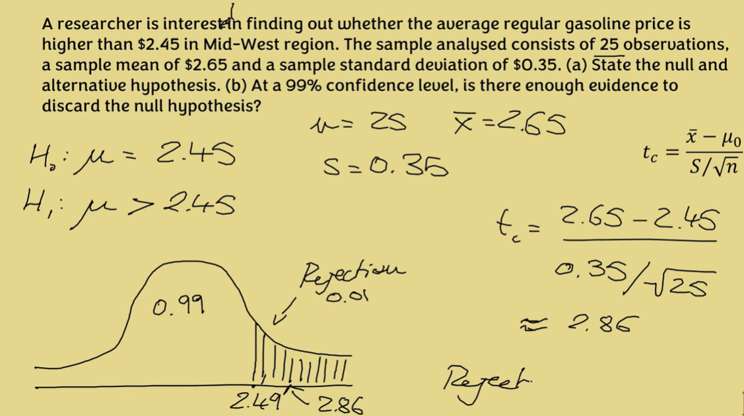

Slide 13
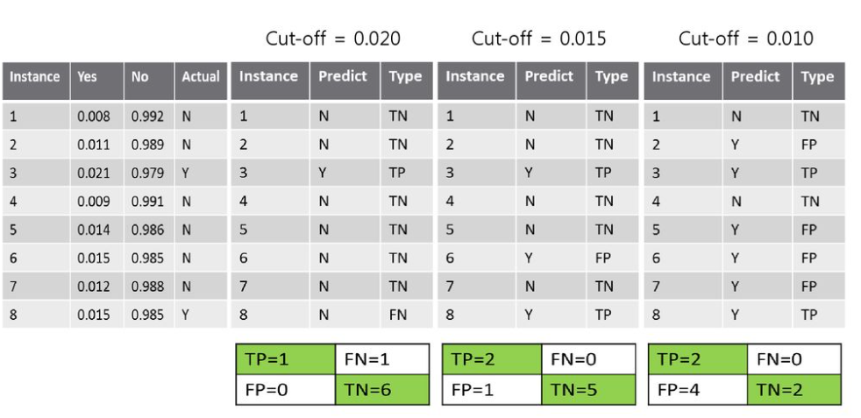
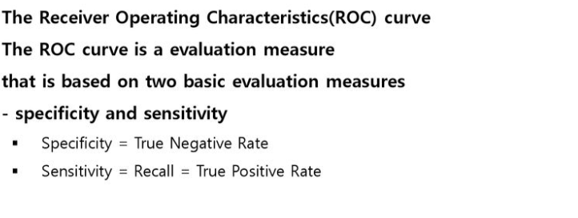
Receiver Operating Characteristics

Slide 14
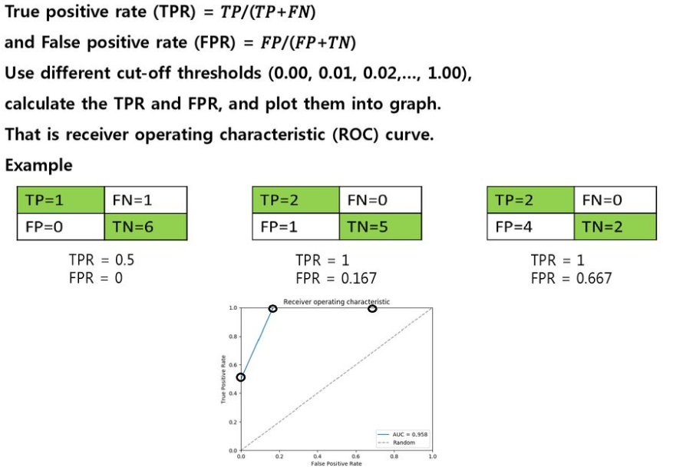
True positive rate vs False positive rate

Slide 15
Example of Changing Thresholds
Score | Prediction for (1) | Prediction for (0.7) | Prediction for (0.6) | Prediction for (0.5) | Prediction for (0) | Y
.25 |  |  |  |  |  | 0
.45 |  |  |  |  |  | 0
.55 |  |  |  |  |  | 1
.67 |  |  |  |  |  | 0
.82 |  |  |  |  |  | 1
.95 |  |  |  |  |  | 1
FP
TP
FPR
TPR

Slide 16
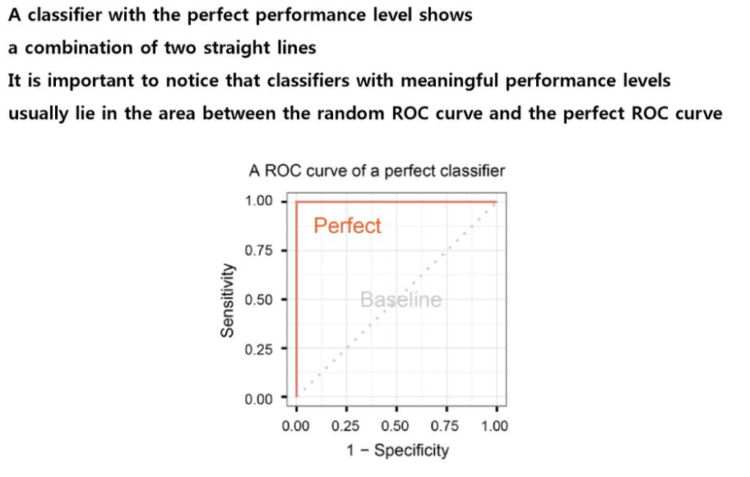
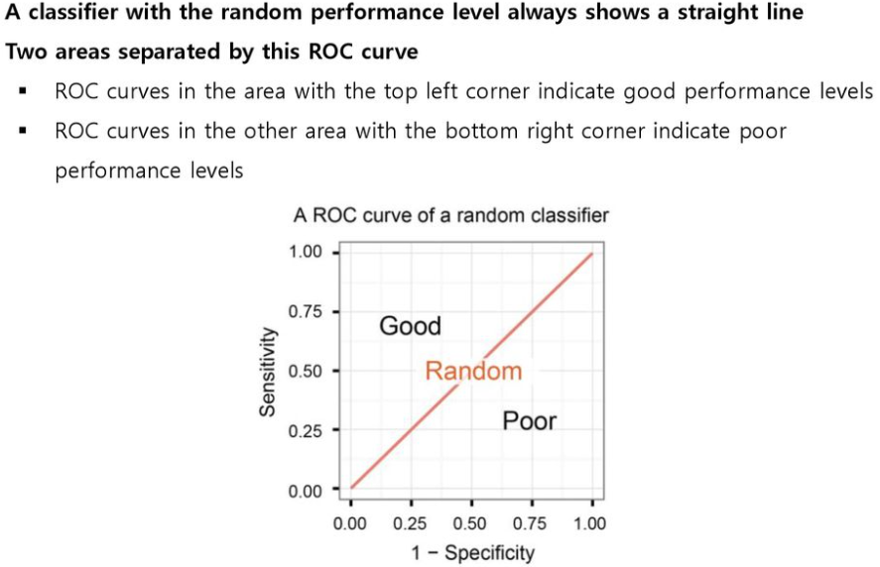
Perfect Classifier

Slide 17
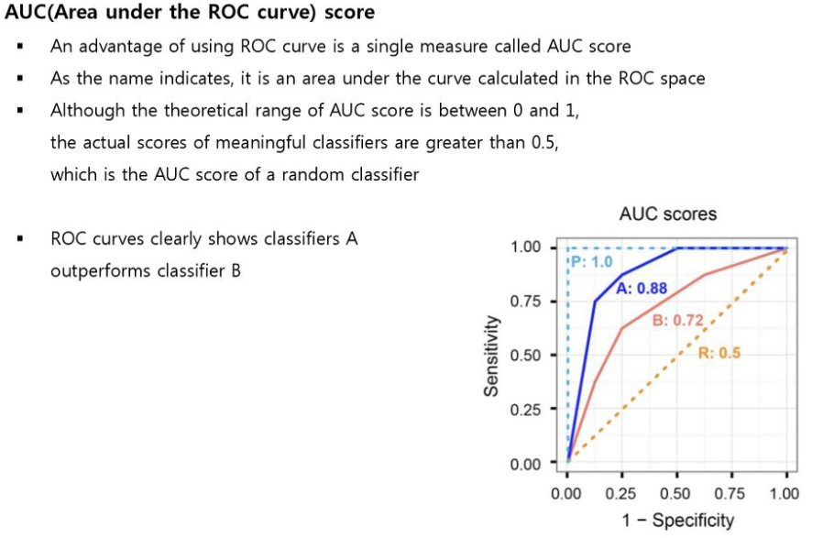
Area Under Curve (AUC)

Slide 18
Threshold value
Threshold .04
Threshold .05
Threshold value decrease :
Positive prediction increase.
True/False Positive increase.
True/False Negative decrease.
Threshold value increase :
Negative prediction increase.
True/False Negative increase.
True/False Positive decrease.
Threshold .03
2) Target TP Rate
Threshold: 0.8
Threshold: 0.83
Interpolate between nearest measurements:
- To achieve 30% FPR, use threshold of ~0.045
Threshold: 0.87
1) Target FP Rate

Slide 19
Classifications and Probability Estimates
What happens if you vary the threshold?
1
Obese
0
weight

Slide 20
Which Model should you use?
 | False Positive Rate | False Negative Rate
Model 1 | 41% | 3%
Model 2 | 5% | 25%
Mistakes have different costs:
Disease Screening – LOW FN Rate
Spam filtering – LOW FP Rate
Actually the same model
- different thresholds

Slide 21
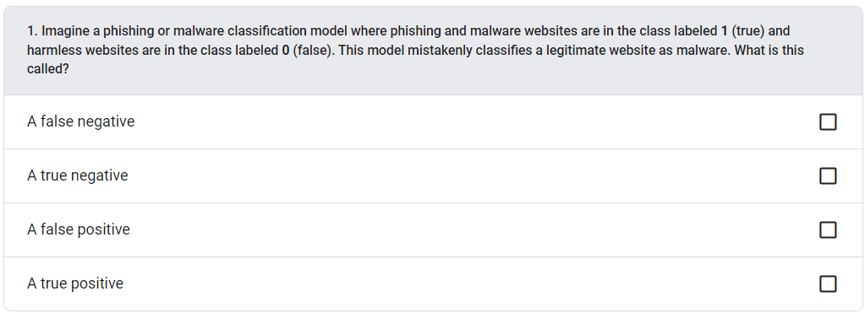
Quiz Question

Slide 22
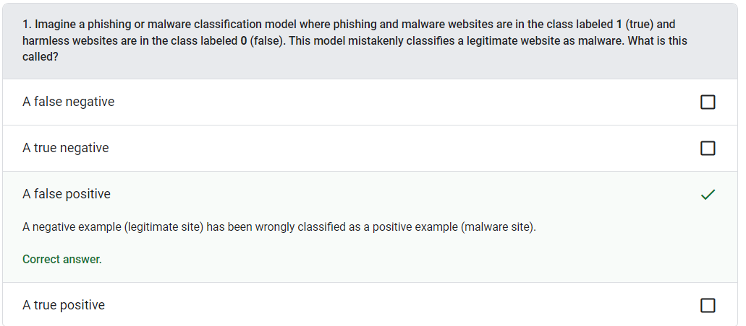

Slide 23
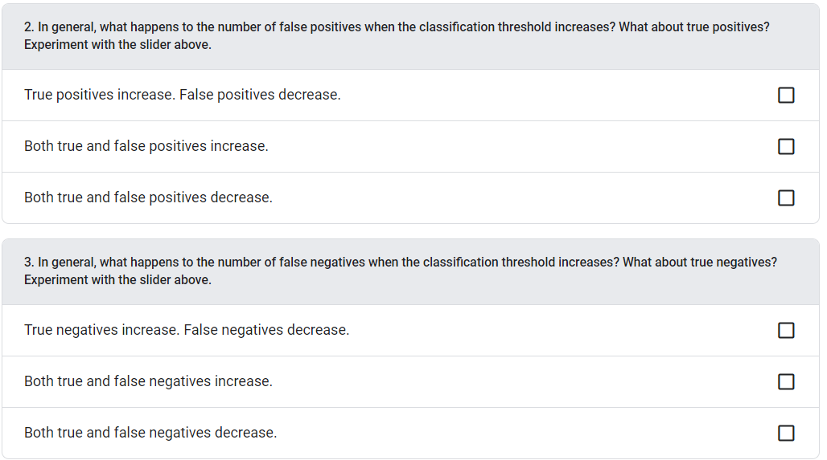
Quiz Question

Slide 24
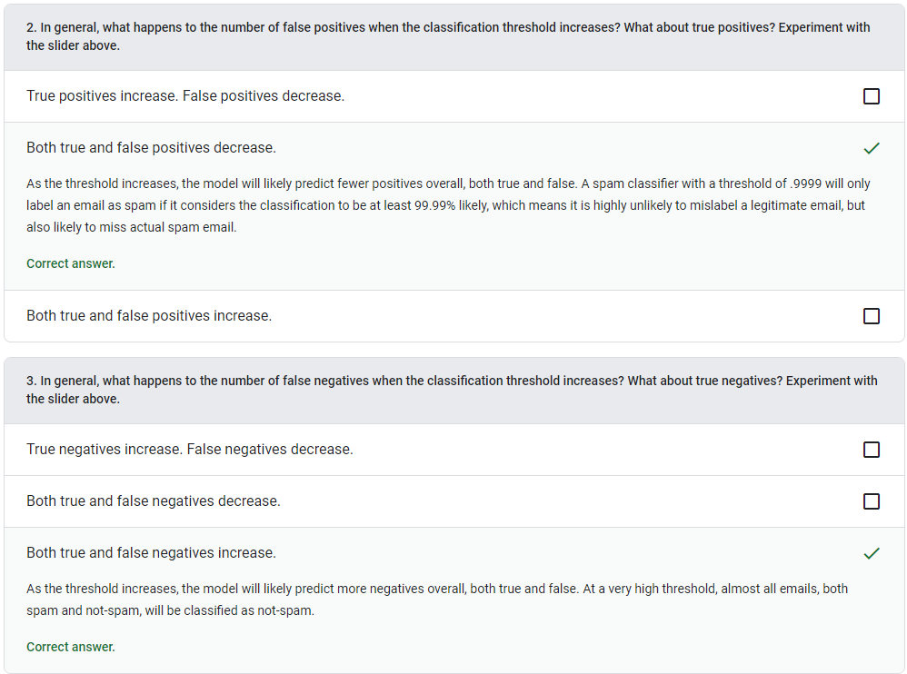

Slide 25
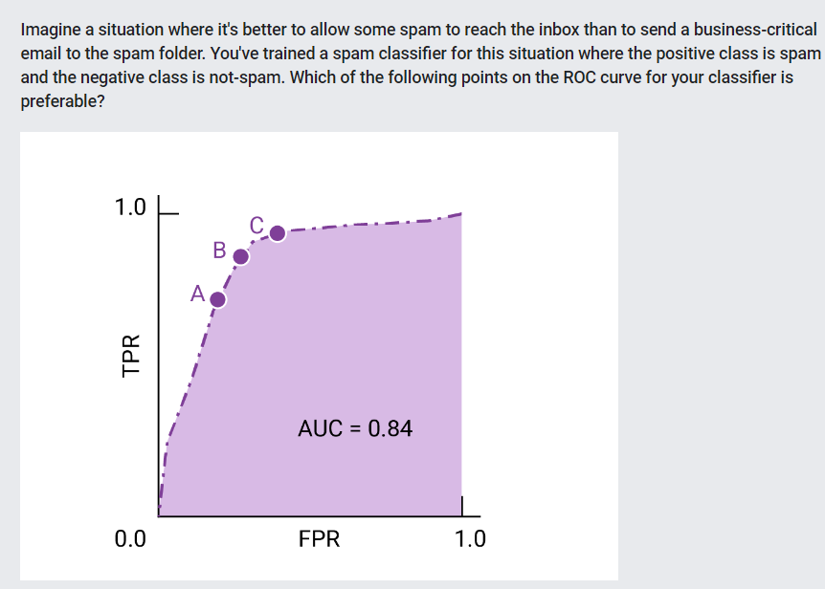
Quiz Question
Answer is A

Slide 26
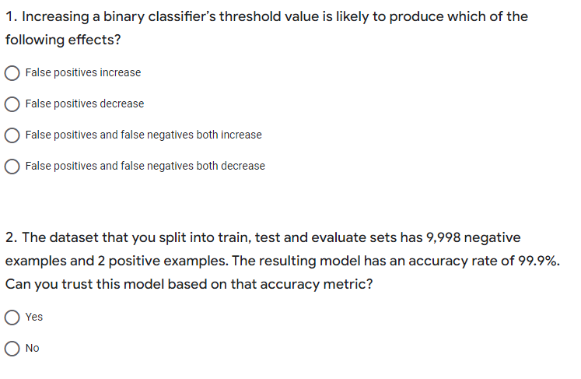

Slide 27
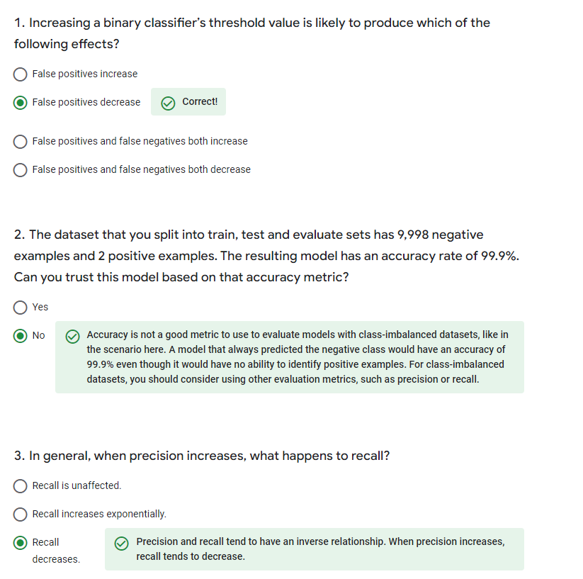

Slide 28
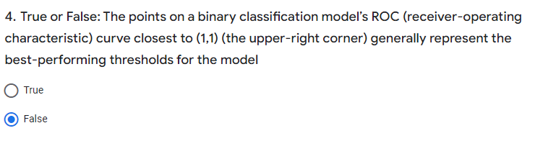

Slide 29
EDA(Exploratory Data Analysis)
Is EDA and data analysis the same?
Data analysis is a broad term involving different types of analysis like descriptive, diagnostic, predictive, and prescriptive. EDA is synonymous with descriptive analysis, where one explores the hidden relationships and patterns in the available data.
How one should write an EDA report?
An EDA report must thoroughly explain the dataset's variables, their correlation, and any preprocessing performed on the dataset to make it suitable for applying a machine learning algorithm for further use in the organization. This report consists of multiple relevant visualizations that present a complete picture of the information in the available data and hence, can be used by senior management to make data-driven decisions.

Slide 30
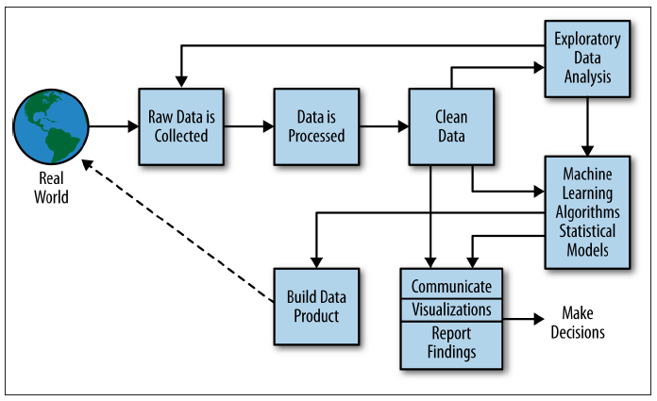
The Data Science Process

Slide 31
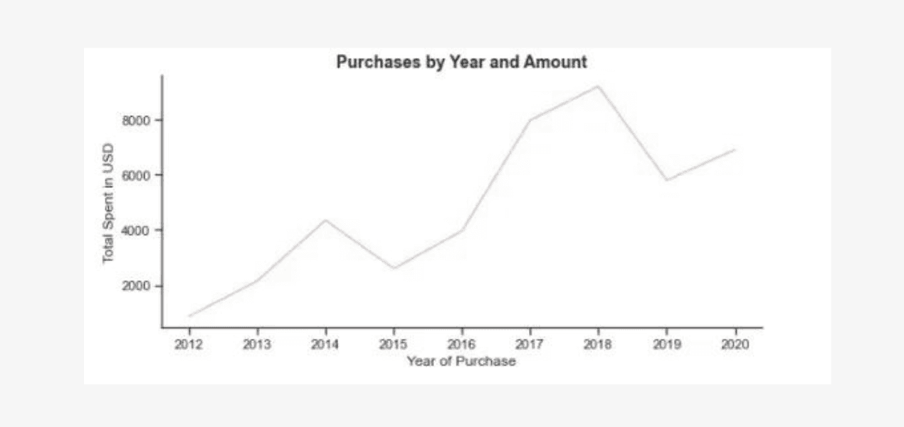
Types of Exploratory Data Analysis
There are four main types of EDA:
Univariate non-graphical
Mean, Mode, Median, Variance, Standard deviation
Univariate graphical
Stem-and-leaf Plots, Histogram, Group Chart, Percentage Chart, Box-plot
Multivariate nongraphical
Correlation, Covariance, Regression Analysis, ANOVA
Multivariate graphical
Scatter plot, Run chart, Bubble chart, heat map, Box-plot

Slide 32
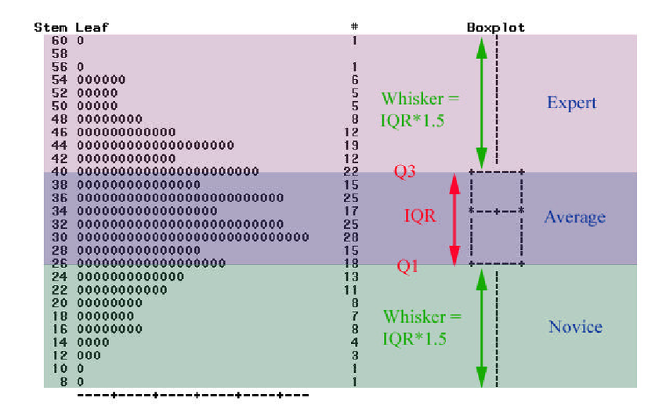
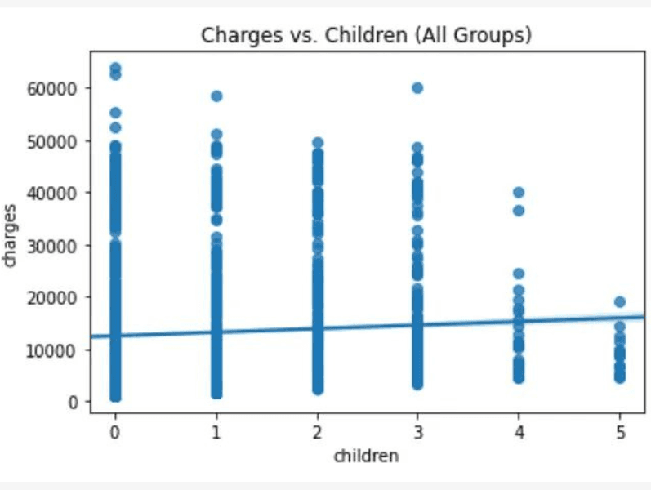
Steam-Leaf Plot – Box Plot
Steam-Leaf Plot

Slide 33
EDA Tools (for plot, Graph & summary statistic)
1. Python
EDA libraries like:
Matplotlib, Pandas, Seaborn, NumPy
You can find many open-source packages in Python, such as D-Tale, AutoViz, PandasProfiling, etc., that can automate the entire exploratory data analysis process and save time.
2. R
R programming language is a regularly used option to make statistical observations and analyze data, i.e., perform detailed EDA by data scientists and statisticians. Like Python, R is also an open-source programming language suitable for statistical computing and graphics.
Apart from the commonly used libraries like: ggplot, Leaflet, Lattice there are several powerful R libraries for automated EDA, such as Data Explorer, SmartEDA, GGally, etc.
3. MATLAB
MATLAB is a well-known commercial tool among engineers since it has a very strong mathematical calculation ability. Due to this, it is possible to use MATLAB for EDA, but it requires some basic knowledge of the MATLAB programming language.

Slide 34
Philosophy of EDA
John Tukey is considered as father of EDA.
Based on following principles:
Revelation : emphasizes using graph
Resistance : general pattern which cover majority of Data.
Reexpression : to new scale to simplify the data analysis

Slide 35
Philosophy of EDA
Exploratory Data Analysis (EDA) is more than just a set of statistical techniques; it's a philosophical approach to understanding data.
1. Curiosity and Open-Mindedness
Questioning:
Openness:
2. Visualization as Storytelling
Visual Communication: EDA recognizes the power of visualization to communicate complex ideas effectively. By creating informative and engaging visualizations, we can tell compelling stories about the data.
Insight Generation:.
3. Iterative Exploration
Continuous Learning: EDA is an iterative process. As we explore the data, we gain insights that can lead to new questions and avenues of exploration.
Refinement: EDA involves refining our understanding of the data through repeated analysis and visualization.
4. Data-Driven Decision Making
Evidence-Based: EDA is grounded in the belief that data-driven decisions are more informed and reliable than those based on intuition or assumptions.
Actionable Insights: EDA aims to provide actionable insights that can be used to guide decision-making and problem-solving.
5. Respect for the Data
Data Integrity: EDA emphasizes the importance of data quality and integrity. It involves cleaning and preparing the data to ensure that it is accurate and reliable.
Ethical Considerations: EDA also considers ethical implications, such as data privacy and bias, when working with data.
In essence, the philosophy of EDA is about using data to understand the world around us, to ask meaningful questions, and to make informed decisions.

